Slide 1

Frontend Engineer Portfolio:
Yue Wen Peter Li
React Developer with cross-disciplinary expertise in computer science, health policy, and social sciences. Ready to bring analytical thinking and creative solutions to your frontend challenges.
PL
by Peter Li

Slide 2




Educational Journey
Northeastern University, Boston
M.S. in Computer Science (GPA: 3.8/4.0)
2023-2025
Web Development, Algorithms, SWD, HCI, AI
Database Systems, Network
National Yang Ming Chiao Tung University
M.S. in Health and Welfare Policy (GPA: 4.1/4.3)
2019-2023
Published research at Population Association of America 2021
Advanced Statistics, Machine Learning
Fu-Jen Catholic University
Dual Degree: B.A. Sociology & B.S. Psychology (GPA: 3.8/4.0) 2014-2018

Slide 3
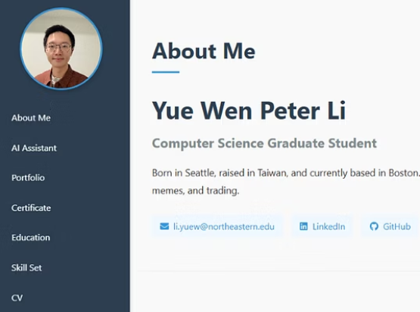
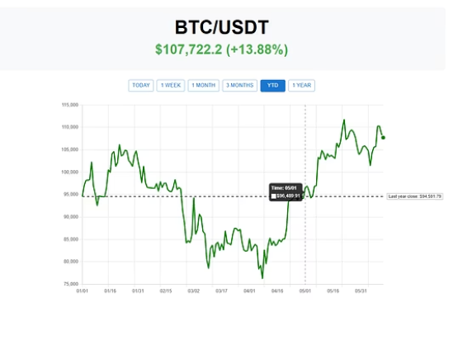
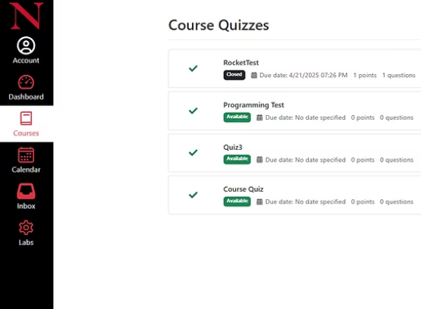
Project Portfolio
Personal Website
Bitcoin Price Tracker
Kambaz E-education
Responsive portfolio built with React and Django.
Real-time cryptocurrency dashboard using APIs and React.
Full-stack education platform mimicking the Canvas LMS.
React App
Click here
Click here

Slide 4








Technical Expertise
Frontend Web Development
React, TypeScript, Redux, Next.js
Backend Server
Node.js, Django
Database Management
MySQL, MongoDB
Deployment
AWS, Netlify, Railway, Run-pod
New graduate full stack developer with specialized frontend expertise.

Slide 5




Value Proposition
Short-term
Website development and optimization
Modern React-based solutions
Responsive design implementation
Mid-term
AI-powered data analysis
Social media data insights
Performance optimization
Long-term
Data-Driven growth strategies
User engagement solutions
Community growth and brand credibility

Slide 6

Thank You For Your Listening
3+
3
4+
Years Coding
Degrees
Portfolio Projects
Committed to continuous learning
Interdisciplinary education
Proven development skills
I look forward to discussing how my technical skills and unique background can contribute to your company's success.

Slide 7


